Slide 1
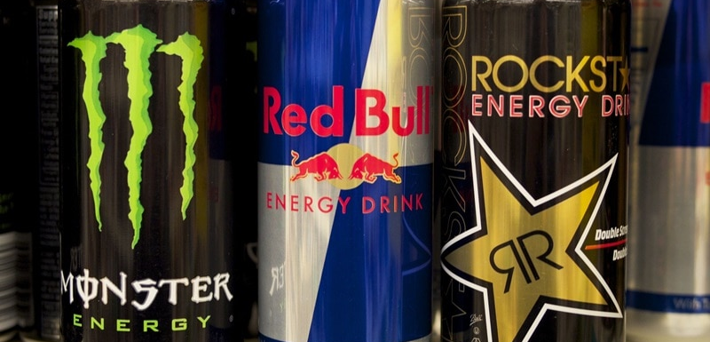

CodeX
CodeX is a German beverage company that is aiming to make its mark in the Indian market. A few months ago, they launched their energy drink in 10 cities in India
My Task is to convert the survey result into a meaningful insights and represent Infront of Chief Marketing Officer

Slide 2

Demographics Insight
Gender Preference
Age Group Preference
Marketing Preference

Slide 3
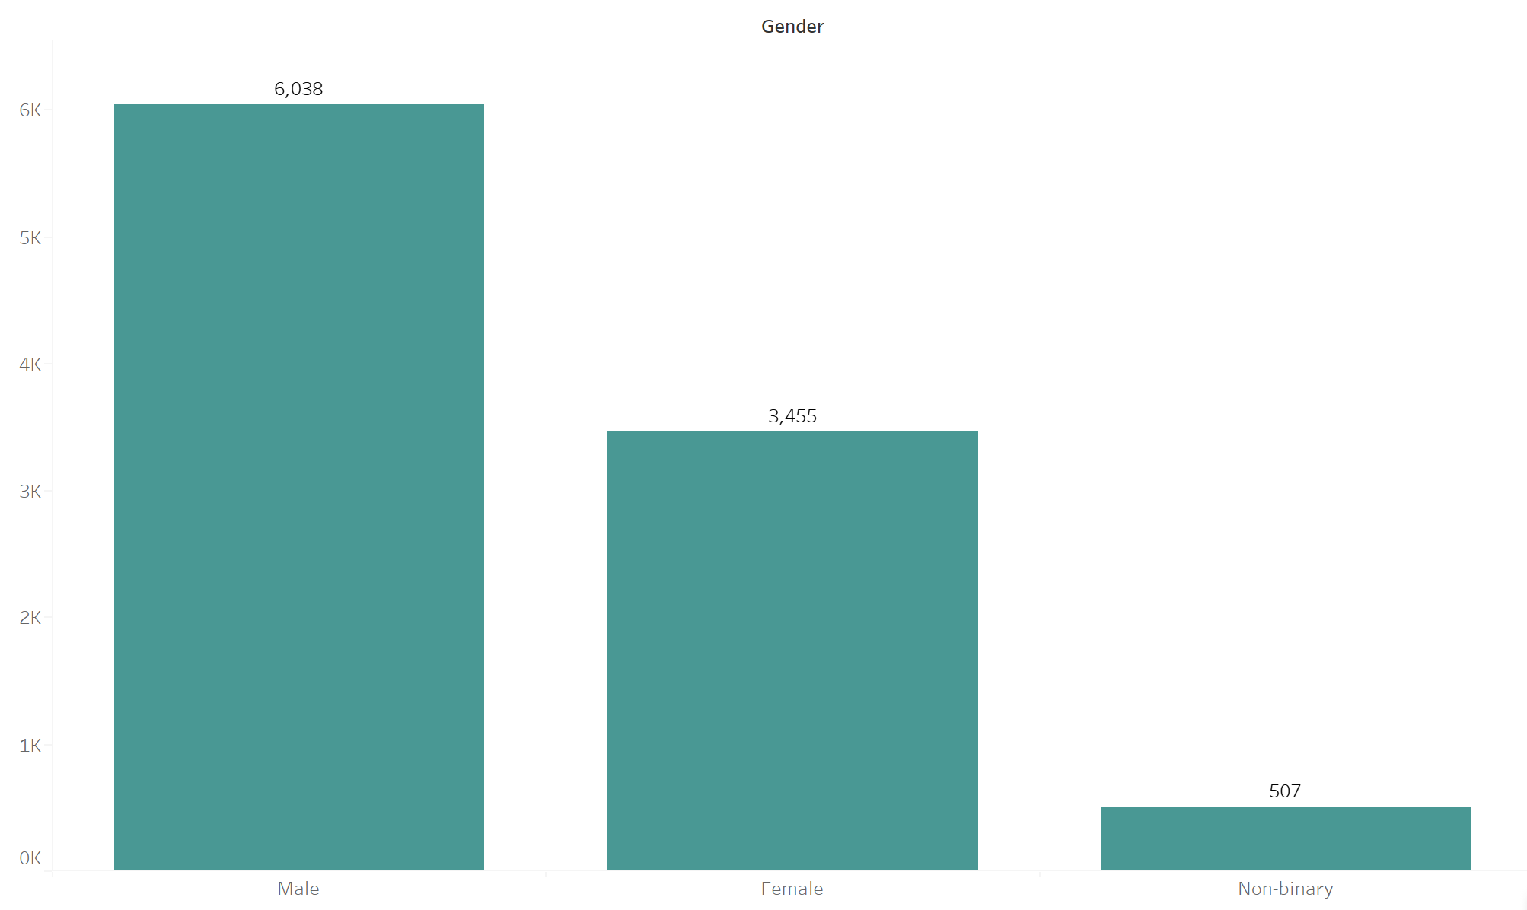
Gender Preference
Out of total respondents Males prefer more energy drinks

Slide 4
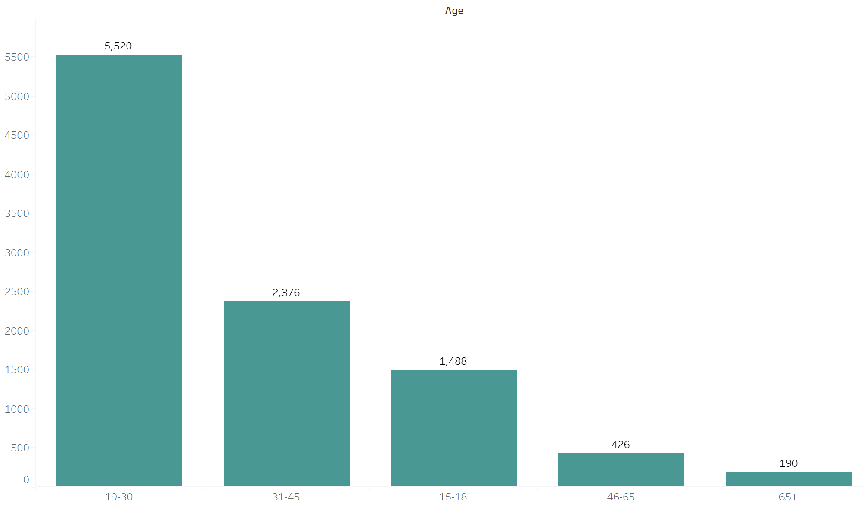
Age Group Preference
19-30 Age group prefer more energy drink

Slide 5
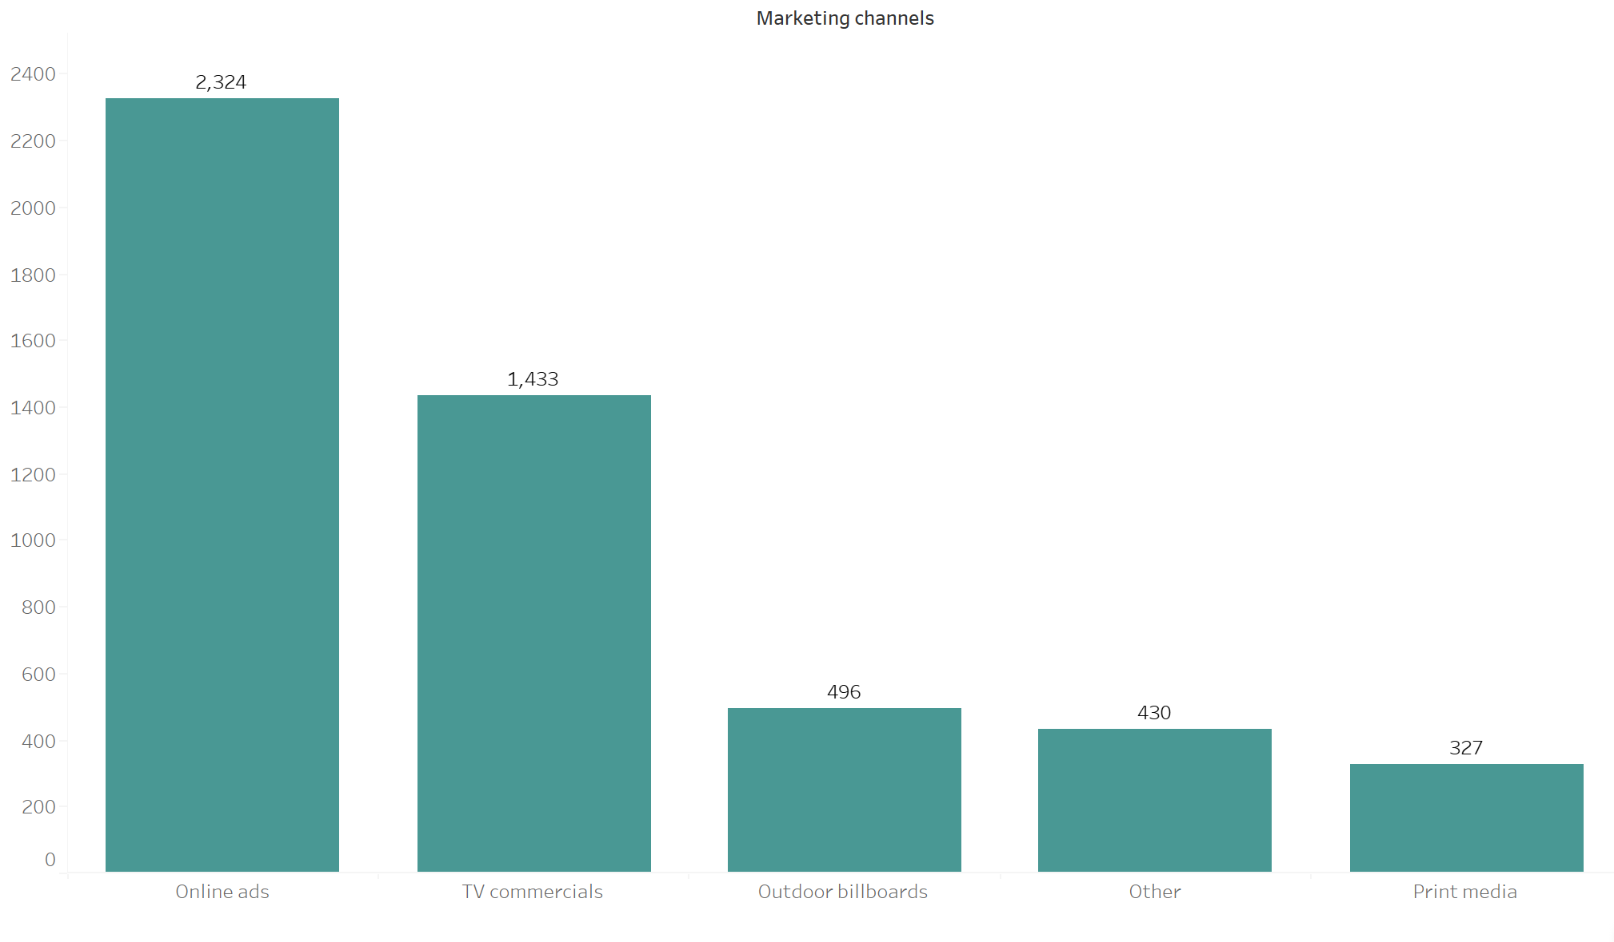
Marketing Preference
I have filtered the age group from 15-30 and Online Ads is the most preferred marketing channel

Slide 6
Consumer Preference Insights
Ingredient
Consumer

Slide 7
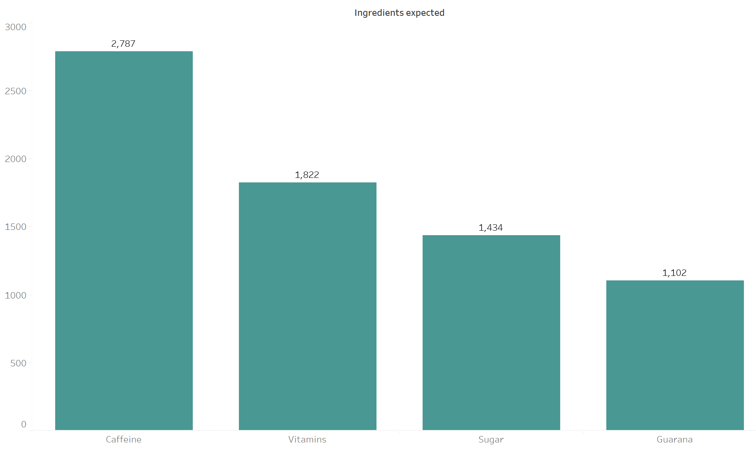
Ingredient Preferences
Caffeine is the most preferred ingredient chosen by the respondents

Slide 8
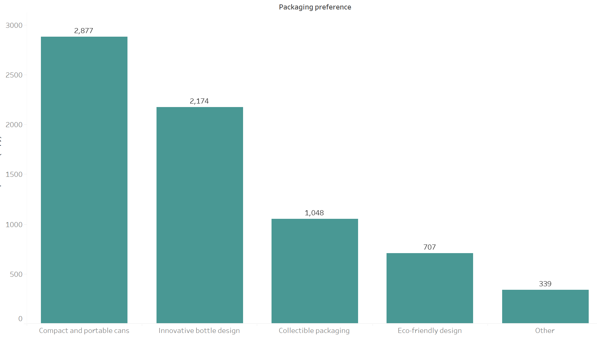
Packaging Preferences
Compact & Portable Cans are the most preferred packaging by the respondents

Slide 9
Competetion Analysis
Current Market Leaders
Primary reasons consumers prefer those brands over us

Slide 10
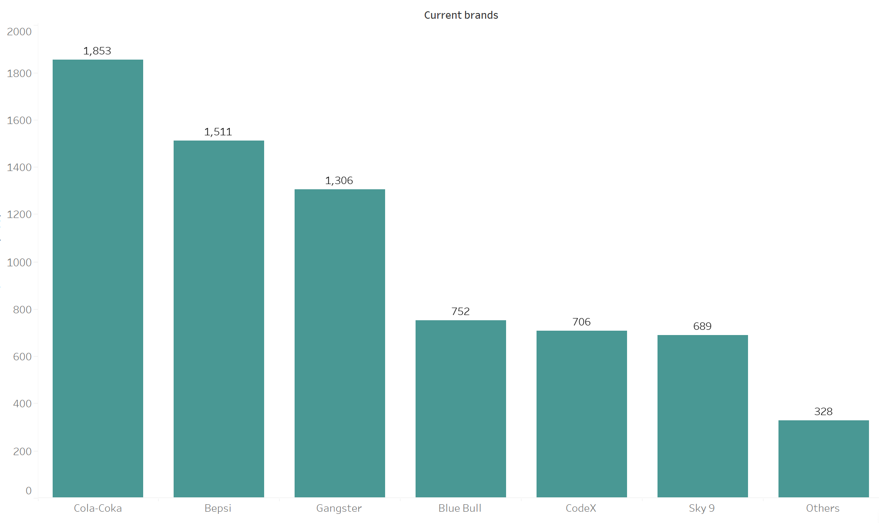
Market Leaders
Cola – Coca is the current market leader

Slide 11
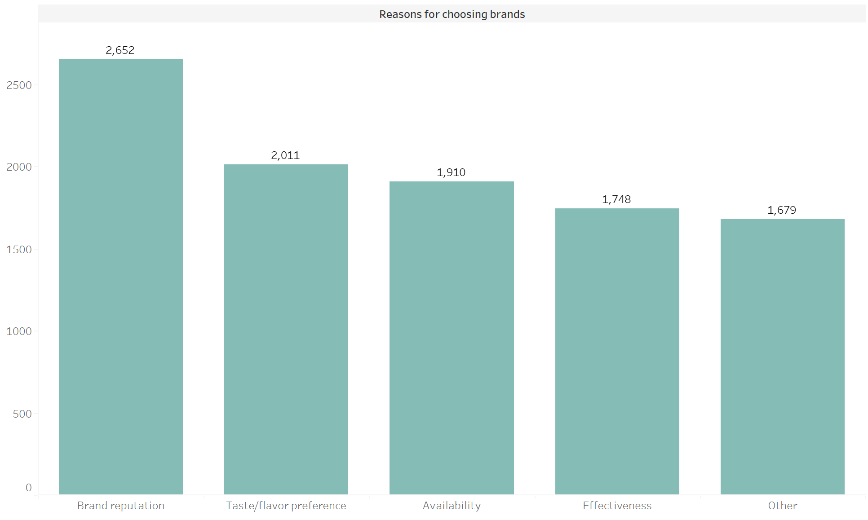
Primary reasons on brand preference
Brand reputation is the most primary reason along with Taste/Flavor preference

Slide 12
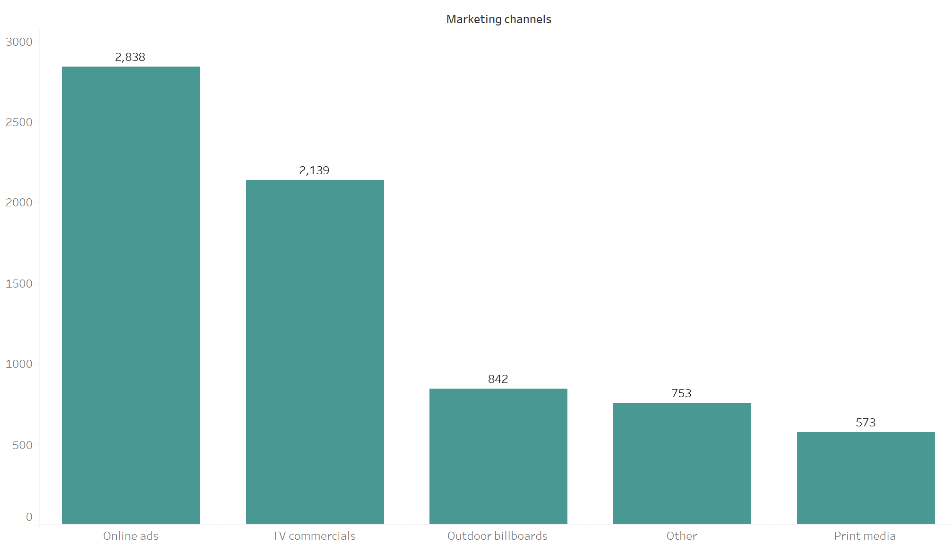
Marketing Channels & Brand Awareness
Online ads are the most preferred marketing channel for branding
Currently most of youth are using smartphones Online ads are the most effective marketing strategy for better reach

Slide 13
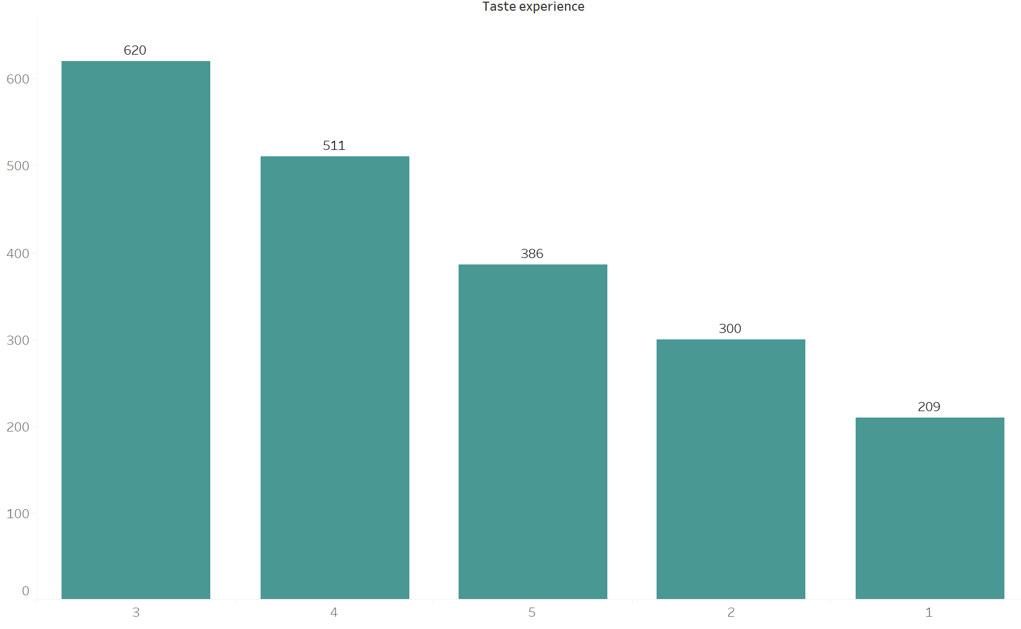
Brand Penetration
The average rating is 3.28

Slide 14
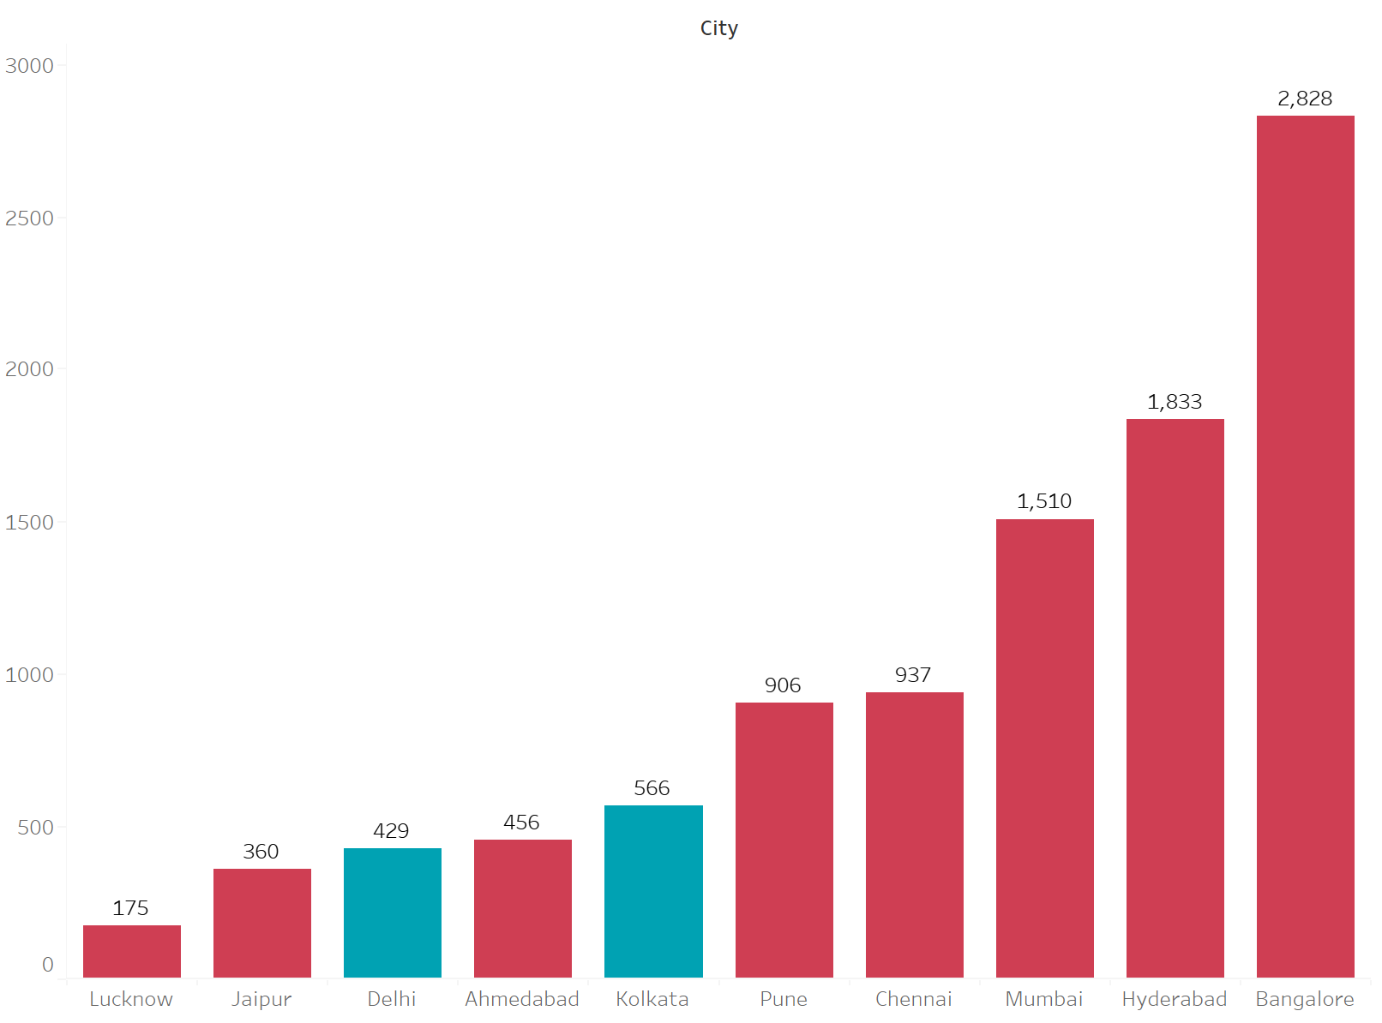
City to focus
Delhi & Kolkata needs to be focused more due to large population

Slide 15
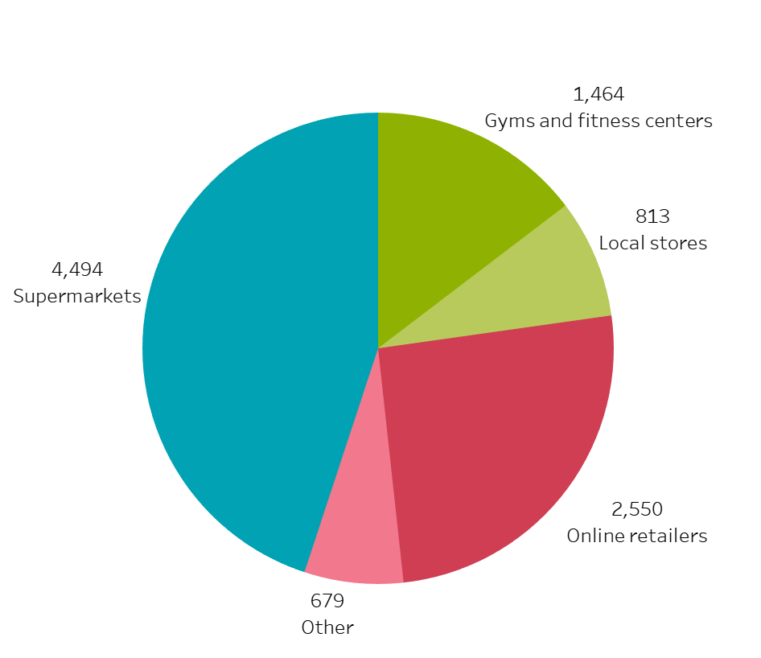
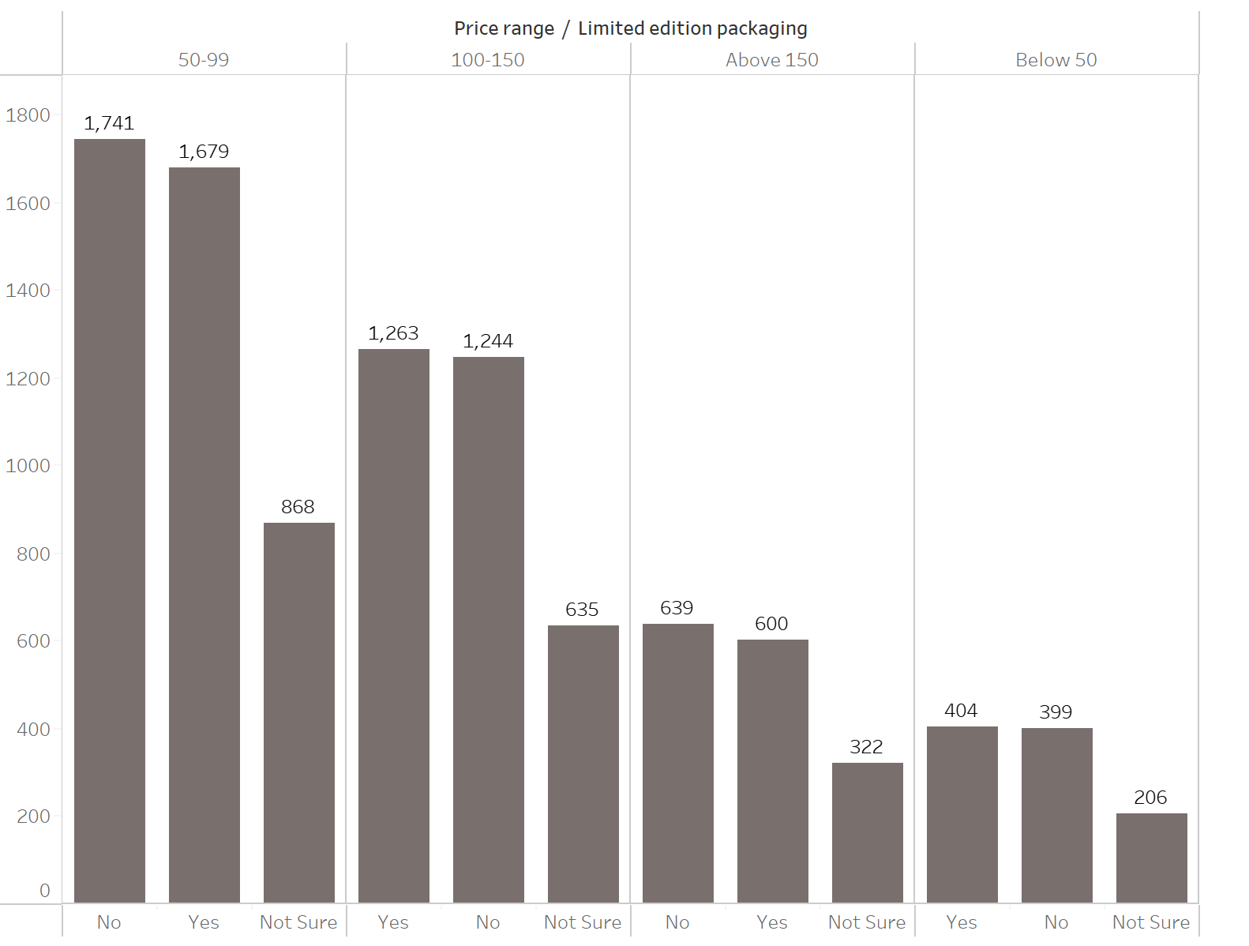
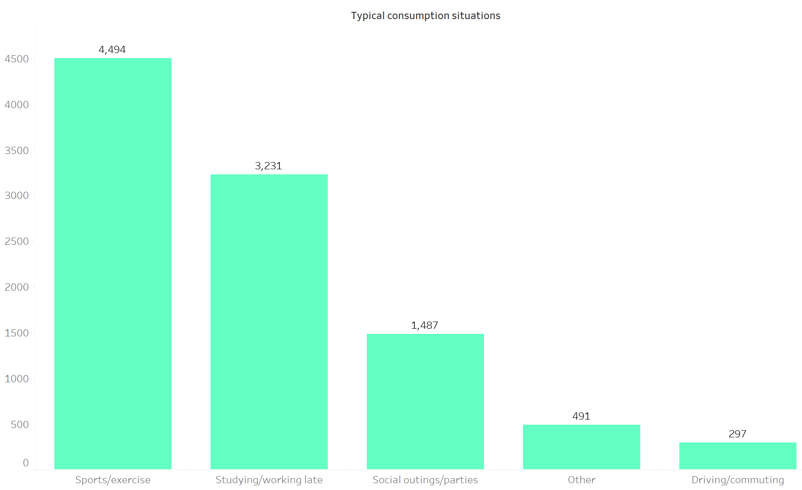
Purchase Behaviour
Supermarket is the convenient channel for the respondents
Respondents want price range between 50-99 but they don’t want Limited Edition Packaging, but 100-150 price range wants limited edition packaging
Most people used to take energy drink before Sports/Exercise

Slide 16
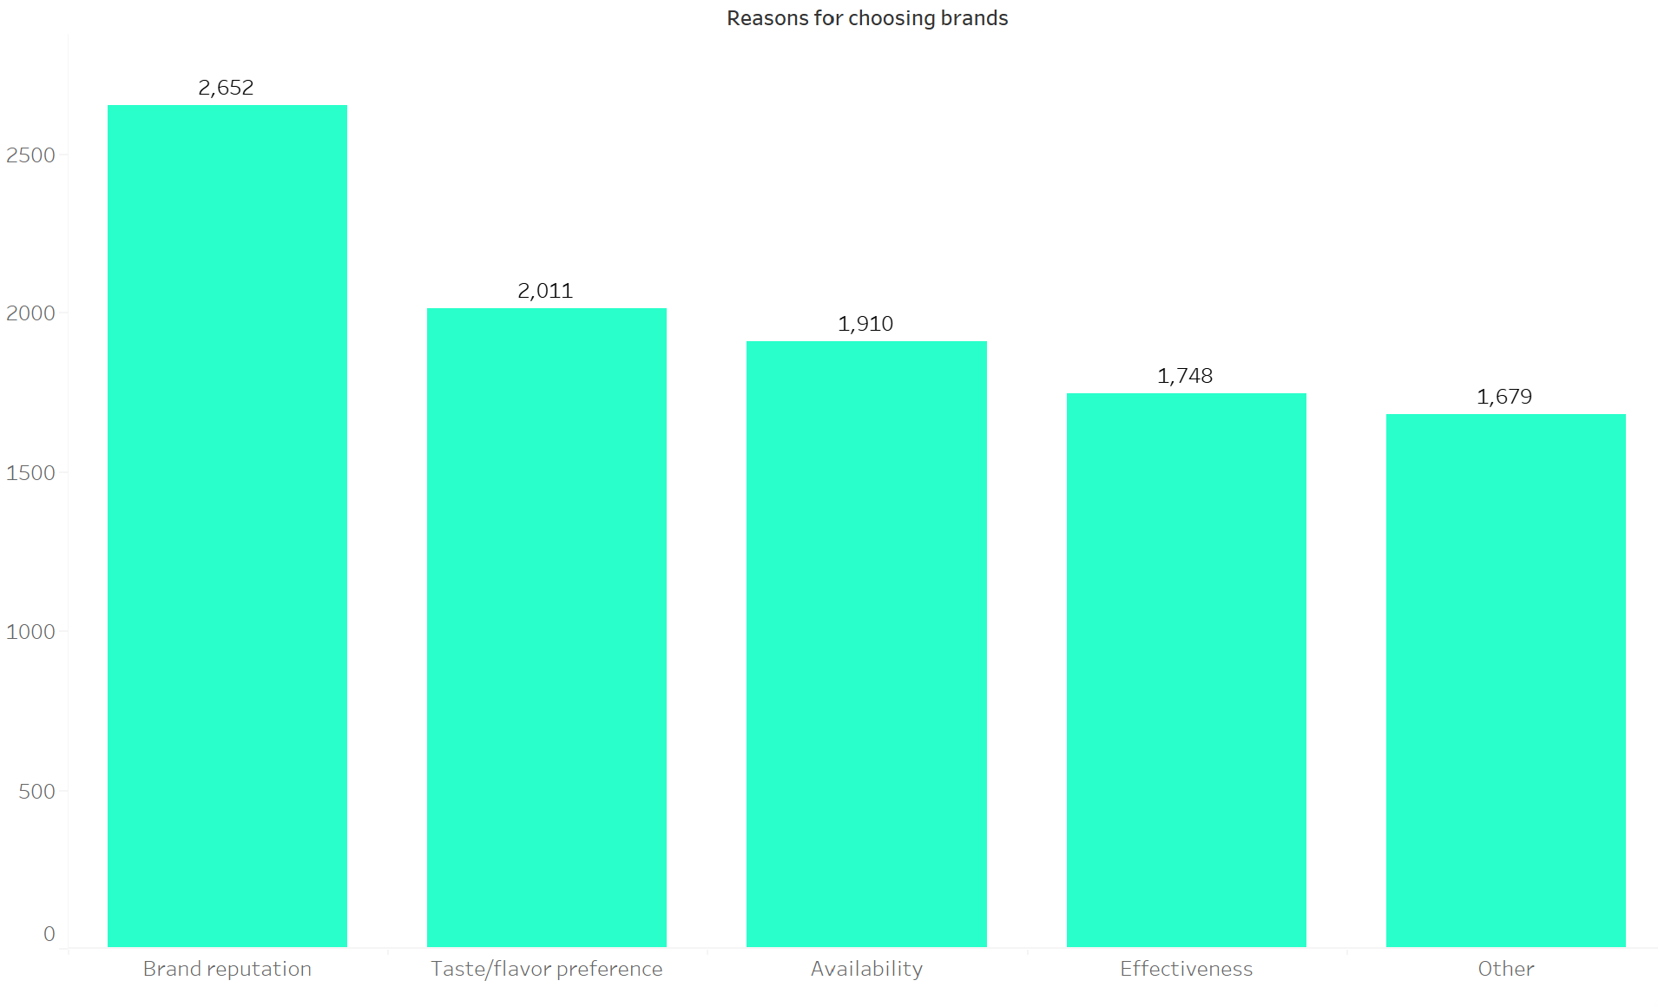
Product Development
Respondents used to choose other brands because of brand reputation
We should more focus on brand reputation
We can collaborate with the India's Sports influencers so they can start doing branding for the CodeX
It will improve the brand reputation

Slide 17

Immediate Improvements
Cola-Coca is the current market leader in energy drink segment & reason for that is brand penetration or brand trust
Our Primary focus needs to be campaigning and reach up to more and more youth for that we needs to start do advertising of the product with great sports fitness icons
Our Secondary focus needs to be reduced sugar content & more natural ingredients according to survey result.
Large people are interested in Natural or Organic Ingredients.
Availability is another feedback people has given so we need to focus on that too.

Slide 18

Ideal Price Range
More people prefer the price range between 50-99 so without compromising the quality we can set our price MRP on 100 if we compare with other energy drink companies.
People tends to like Limited Edition product too so we can also launch a limited-edition product with 150 price. People who tends to pay more but don’t want to compromise with taste and quality.

Slide 19

Marketing campaigns, offers & discount
Most people buying energy drinks in Supermarket, so we need to put big posters of Code-X for more brand visibility.
For increasing the sale, we can provide 10% discount for 3 months and more offers like Buy 3 GET 1 Free
MRP : 100 , Discounted Price : 90
Buy 3 get 1 free 300/4 = 75 effective price
We can collect the data for 3 months and analyze how it has performed and later on we can extend the offer if we need it.

Slide 20
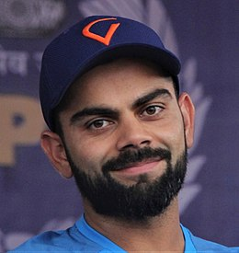
Brand Ambassador
We can choose Virat Kohli as Brand Ambassador.
He is a great Social Media influencer & fittest player on Indian Cricket team

Slide 21

Target Audience
19-30 age group takes more energy drink
We should target 19-30 more through various social media channels like Instagram, Facebook, YouTube etc
Online ads are the most preferred Marketing channel by youth

Slide 22

Thank You

